Slide 1
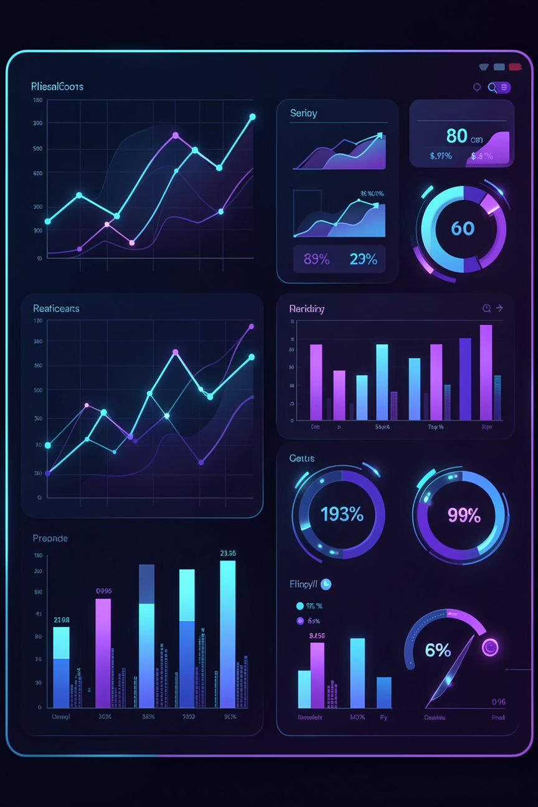
FinSight – Money Manager
Smart Finance. Clear Sight.
Notes:
1

Slide 2


What Is Finsight?
Finance + Insight
The Vision
Finsight combines raw financial data with intelligent processing — turning transactions into clarity and action.
Most people don't lack money — they lack visibility. Finsight turns spending data into meaningful, actionable insights.
The Real-World Problem
People struggle to track where their money goes. Finsight simplifies that with a smart, centralized backend system.
Notes:
2

Slide 3

The Problem
Expense Blindness
Most individuals have no real-time visibility into where their money is going each month.
No Financial Awareness
Without structured tracking, overspending goes unnoticed until it's too late.
Manual Calculation Hell
Spreadsheets and paper logs are error-prone, time-consuming, and simply don't scale.
Notes:
3

Slide 4
Our Solution
Finsight delivers a robust, API-driven backend that handles everything from data ingestion to secure categorized reporting.
Centralized Management
Secure API Backend
Smart Categorization
One system for all financial data — expenses, income, and categories — structured and queryable.
REST APIs protected by Spring Security and JWT ensure only authenticated users access sensitive data.
Expenses are automatically tagged and grouped, enabling insightful reports without manual effort.
Notes:
4

Slide 5
Technology Stack — Deep Dive
Java
1
The foundational programming language for the entire backend. Leverages its robust ecosystem, strong typing, and JVM capabilities for high performance and reliability.
Spring Boot
2
Eliminates boilerplate configuration. Auto-wires dependencies and launches a production-ready server in minutes, letting the team focus on business logic.
MySQL
3
Structured relational storage for users, expenses, and categories. ACID-compliant transactions ensure data integrity at every operation.
JPA / Hibernate
4
Maps Java entity classes to database tables automatically. Reduces raw SQL and enables powerful query methods through repository interfaces.
JWT Auth
5
Stateless token-based authentication. Every API request carries a signed token — no session state needed on the server side.
Notes:
5

Slide 6
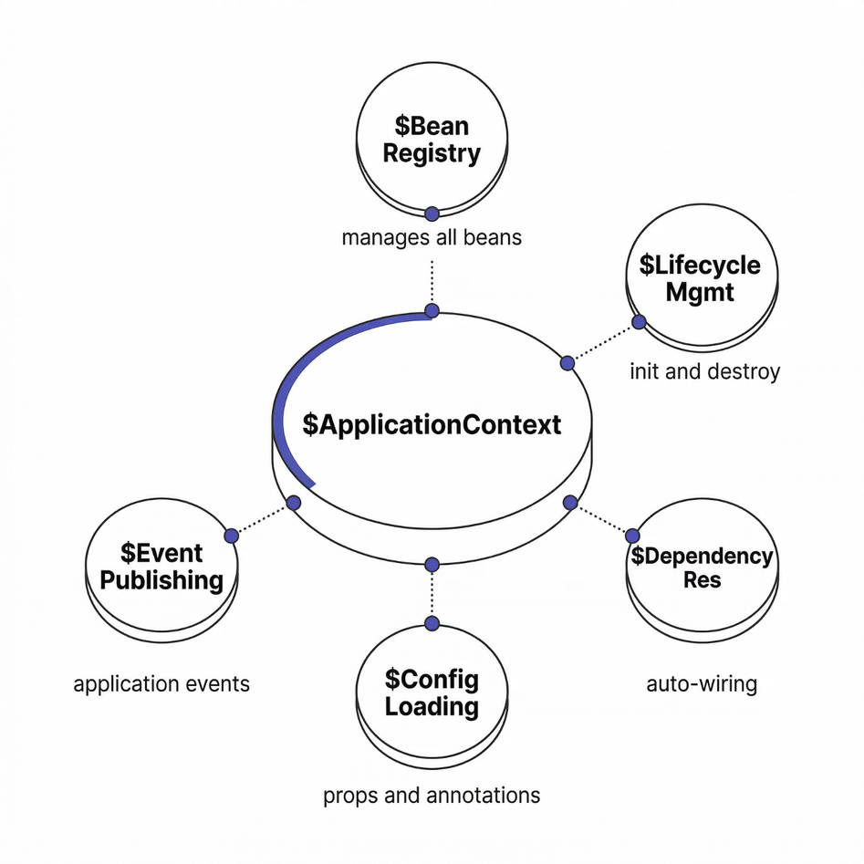

ApplicationContext — The Brain of Spring
The ApplicationContext is Spring's central container. It bootstraps the entire application — scanning components, wiring beans, and managing their full lifecycle from creation to destruction.
Think of it as the runtime brain of your Spring app — every service, repository, and component lives inside it.
ApplicationContext context =
SpringApplication.run(App.class, args);
UserService userService =
context.getBean(UserService.class);
Notes:
6

Slide 7
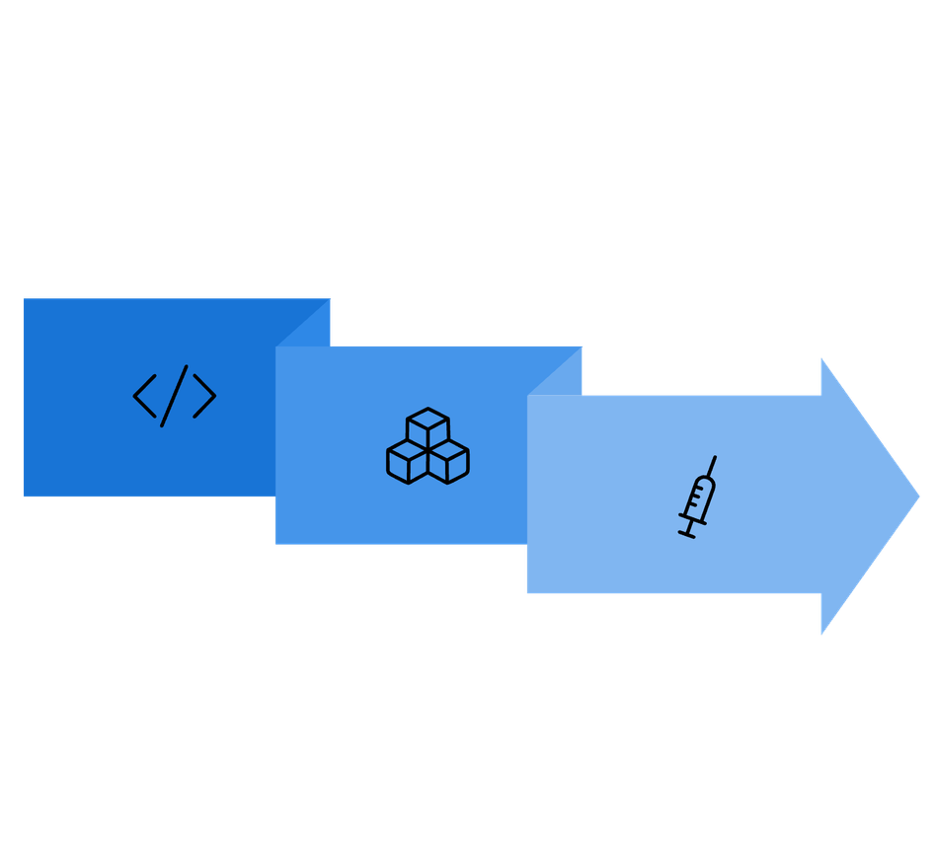
Inversion of Control & Dependency Injection
Inversion of Control (IoC)
Traditional Code
Instead of your code calling new UserService(), you annotate the class and Spring manages instantiation.
Dependency Injection
@Service
public class UserService { }
Dependency Injection (DI)
Spring automatically injects required dependencies into your classes — no manual wiring needed.
IoC Container
@Autowired
private UserRepository userRepository;
IoC flips the control model — you declare what you need, and Spring handles the wiring. DI is how that happens in practice.
Notes:
7

Slide 8

Spring Beans
A Spring Bean is any object whose lifecycle — creation, configuration, and destruction — is managed entirely by the Spring container. Declare once, use anywhere.
@Component
@Service
Generic Spring-managed bean. Use for utility classes and shared services.
Marks business logic classes. Semantically meaningful for layered architecture.
@Repository
Data access layer beans. Spring adds exception translation automatically.
@Component
public class ExpenseService { }
Notes:
8

Slide 9
Why These Concepts Matter for Finsight
Architectural Benefits
1
Loose Coupling
Services don't instantiate their own dependencies — they receive them. Swap implementations without touching business logic.
2
Easy Testing
Inject mock repositories in unit tests. No Spring context needed — fast, isolated, reliable test suites.
3
Scalable Architecture
IoC and DI are the foundation of Finsight's layered design — Controller → Service → Repository — each layer independently maintainable.
Notes:
9

Slide 10

FINSIGHT — MONEY MANAGER
Layered Architecture
A clean separation of concerns — from HTTP request to database response — built with Spring Boot best practices.
Notes:
10

Slide 11
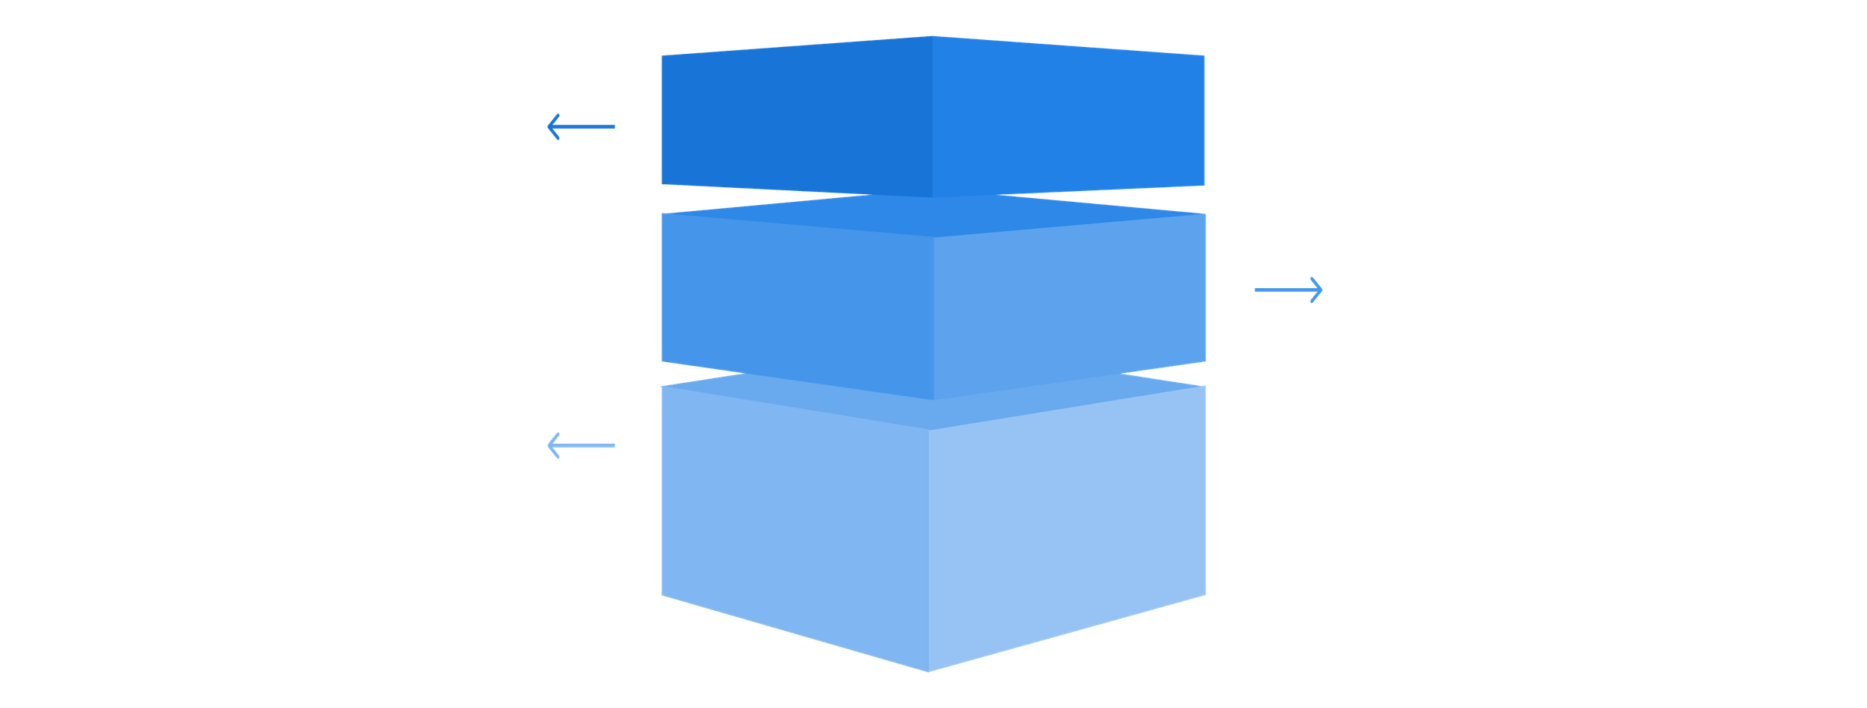
The Three-Layer Architecture
Our application is structured into three distinct layers, each with specific responsibilities, ensuring clear separation of concerns and efficient data flow.
Repository
Manage data persistence and retrieval.
Service
Encapsulate business logic and coordinate operations.
Controller
Handle requests and orchestrate responses.
This architectural pattern simplifies maintenance, promotes reusability, and enhances the overall scalability of the Finsight application.
Notes:
11

Slide 12
Controller Layer
The entry point of every API call. Controllers handle HTTP requests, validate input format, and delegate processing to the Service layer.
@RestController
@RestController
@RequestMapping("/api/expenses")
public class ExpenseController {
@Autowired
private ExpenseService expenseService;
@PostMapping
public Expense addExpense(
@RequestBody Expense expense) {
return expenseService
.saveExpense(expense);
}
}
Marks the class as a REST API endpoint — combines @Controller and @ResponseBody.
@RequestMapping
Binds the controller to /api/expenses — all routes in the class are relative to this base path.
@PostMapping
Maps HTTP POST requests to addExpense(), accepting a JSON body and returning the saved entity.
Notes:
12

Slide 13
Service Layer — Business Logic
The heart of the application. The Service layer encapsulates all business rules, validations, and transformations before data reaches the database.
@Service
public class ExpenseService {
@Autowired
private ExpenseRepository repository;
public Expense saveExpense(
Expense expense) {
// validations go here
return repository.save(expense);
}
}
@Service
Validation
Registers this class as a Spring-managed bean in the application context.
Business rules — amount checks, category validation — live here, never in the Controller.
Delegation
After processing, delegates persistence to the ExpenseRepository.
Notes:
13

Slide 14
Repository Layer — Data Access
The bridge between Java and the database. By extending JpaRepository, the repository gets a full suite of CRUD operations with zero boilerplate.
@Repository
public interface ExpenseRepository
extends JpaRepository
<Expense, Long> {
// CRUD methods provided
// automatically by Spring Data JPA
// Custom queries can be added here
List<Expense> findByCategory(
String category);
}
Zero Boilerplate
Extending JpaRepository auto-generates save(), findAll(), deleteById(), and more.
Query Methods
Spring Data derives SQL from method names — findByCategory() generates the query automatically.
@Repository
Enables exception translation — converts low-level DB exceptions into Spring's unified DataAccessException.
Notes:
14

Slide 15
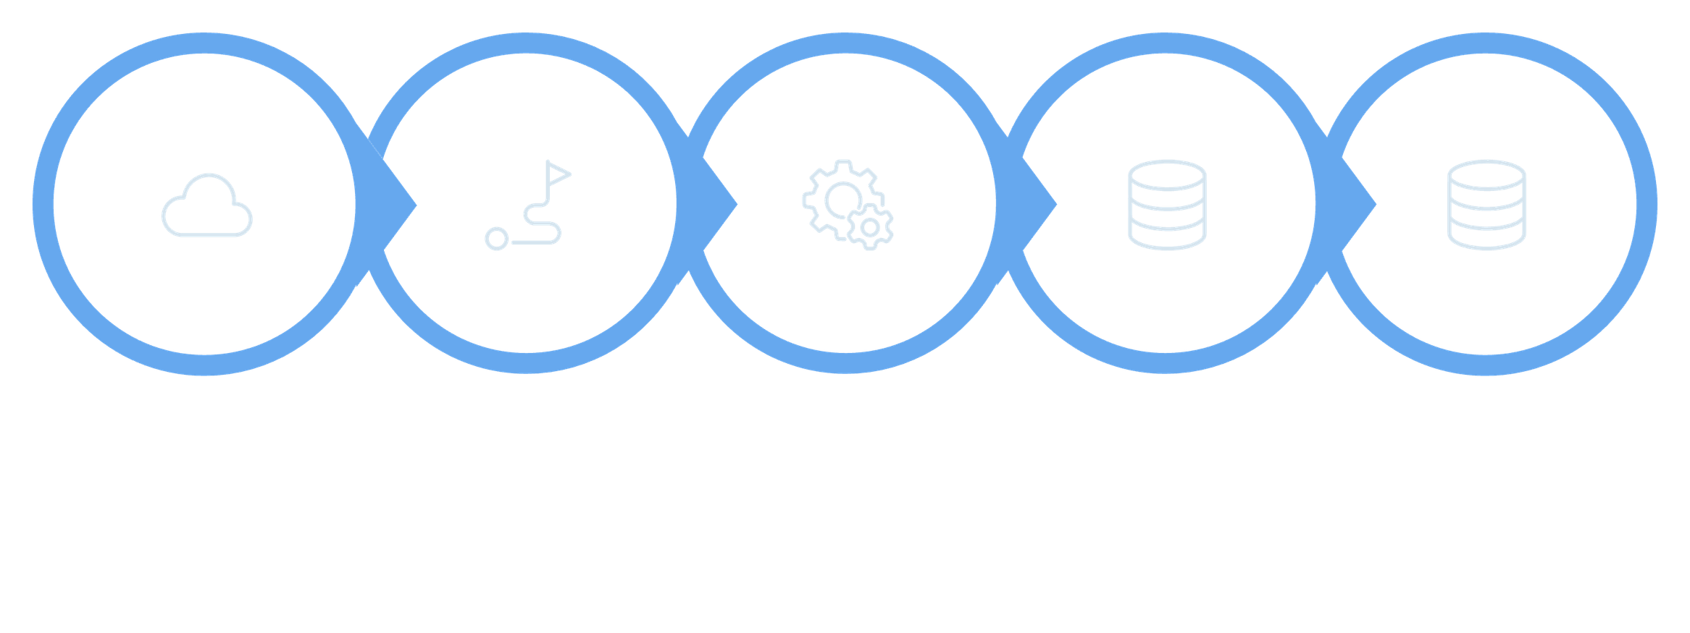
Full Request Flow
Every API call in Finsight travels through all layers in sequence — each layer responsible for exactly one concern.
API Request
Controller
Service
Repository
Database
This unidirectional flow ensures predictable behavior, straightforward debugging, and clean unit test boundaries at every layer.
Notes:
15

Slide 16
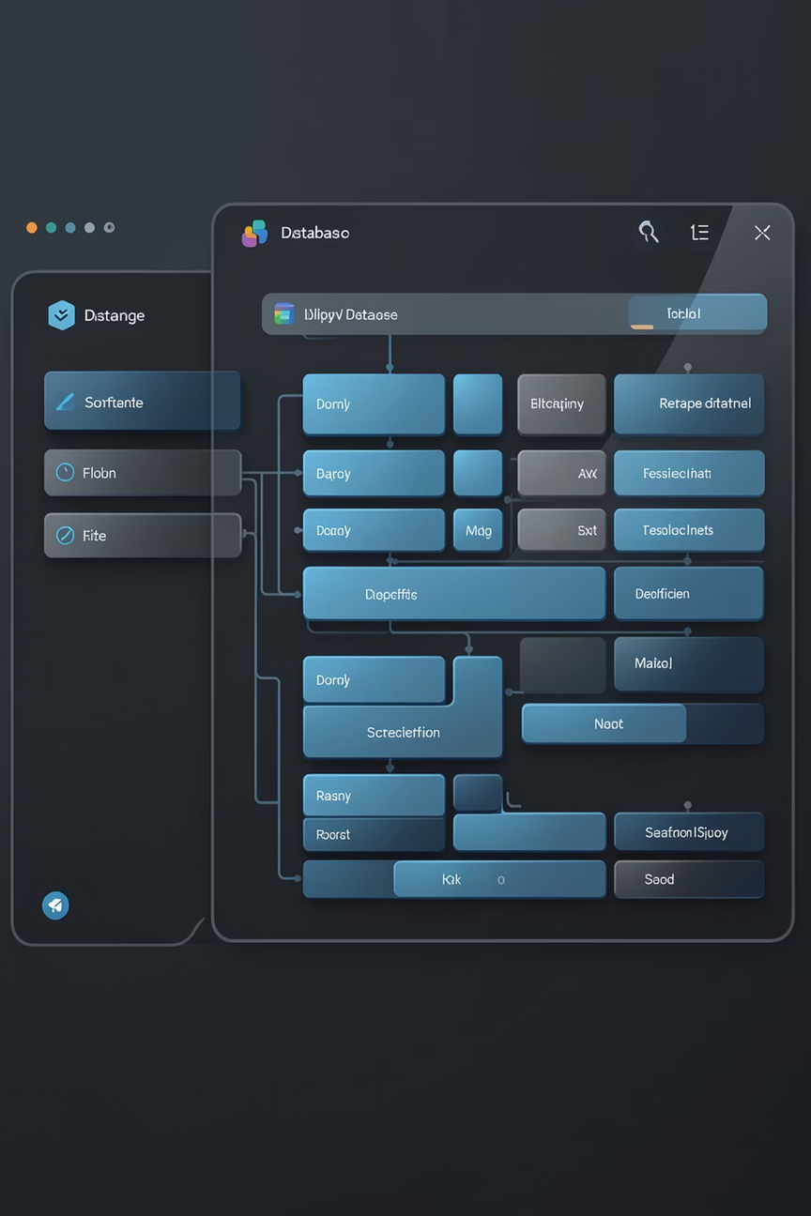
FINSIGHT — MONEY MANAGER
Database & Persistence
JPA and Hibernate power Finsight's data layer — mapping Java objects to relational tables with minimal configuration.
Notes:
16

Slide 17


Entity Class & DTO
The Entity represents the database table. The DTO controls what data is exposed through the API — keeping internal structure private.
Entity — maps to DB table
DTO — safe data transfer
@Entity
public class Expense {
@Id
@GeneratedValue
private Long id;
private String category;
private double amount;
}
public class ExpenseDTO {
private String category;
private double amount;
// Getters & Setters
}
The DTO omits the id field — preventing internal IDs from leaking through the public API response.
Annotated with @Entity — Hibernate automatically creates and manages the corresponding table.
Notes:
17

Slide 18
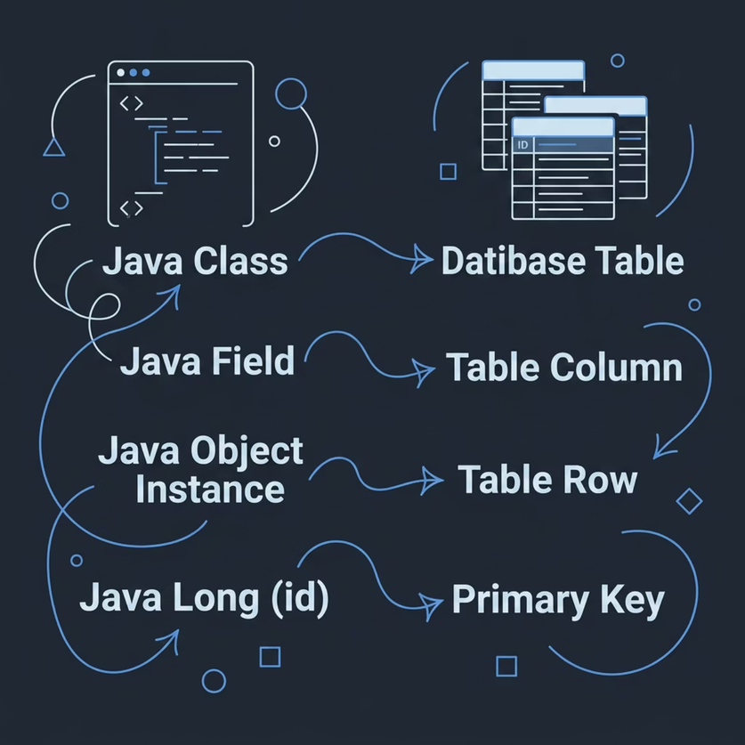





JPA, Hibernate & ORM
ORM Mapping
JPA
Hibernate
Specification — defines the standard API for ORM in Java (interfaces, annotations, rules).
Implementation — the engine that executes JPA rules, generating SQL and managing sessions.
Entity Lifecycle
Transient
Object created, not yet tracked
Persistent
Managed by Hibernate session
Detached
Session closed, no longer tracked
Removed
Scheduled for deletion from DB
ORM eliminates raw SQL for standard operations — Hibernate translates object interactions directly into database queries.
Notes:
18

Slide 19

Spring Security + JWT Authentication Flow
This backend security system implements stateless authentication using Spring Security and JSON Web Tokens (JWT). Unlike traditional session-based authentication, JWT provides a scalable, distributed solution where each request carries its own authentication credentials. The flow begins with user login and password verification using BCrypt hashing, proceeds through JWT token generation, and establishes a security filter chain that validates tokens on every subsequent request.
Notes:
19

Slide 20




Security ArchitectureComponents
Authentication
JWT Generation
Verifies user identity through credentials. AuthenticationManager validates email and password using UserDetailsService to load user data from the database and BCrypt for secure password hashing comparison.
Creates cryptographically signed tokens containing user claims after successful authentication. JwtUtil generates tokens with expiration time and user details, returned to frontend for storage in localStorage or cookies.
Security Filter Chain
Authorization
Intercepts every HTTP request through configured filters. JwtRequestFilter extracts tokens from Authorization headers, validates signatures, verifies expiration, and sets Authentication objects in SecurityContext for downstream authorization.
Determines access rights after authentication. Uses role-based or permission-based checks to control endpoint access. Spring Security annotations like @PreAuthorize enforce business logic security rules before controller methods execute.
BCrypt Password Encoder
Authentication Manager
@Bean
public PasswordEncoder passwordEncoder() {
return new BCryptPasswordEncoder();
}
authenticationManager.authenticate(
new UsernamePasswordAuthenticationToken(
email,
password
)
);
Notes:
20

Slide 21



Complete Flow: Add Expense Example
User Login Request
POST /login with email and password credentials. AuthenticationManager delegates to UserDetailsService which queries database for user entity, then BCrypt matches hashed password stored in database.
Token Generation & Response
Upon successful authentication, JwtUtil generates JWT containing user ID, roles, and expiration timestamp. Token is serialized in JSON response body for frontend to store securely.
Frontend Stores Token
Client application (React, Angular, or mobile app) saves JWT in memory or persistent storage. Subsequent requests automatically include Authorization header with "Bearer" prefix.
Expense Request with Token
POST /expense with JSON body containing amount and Authorization header. SecurityFilterChain routes request through JwtRequestFilter before reaching controller.
Token Validation
JwtRequestFilter extracts token from header, verifies digital signature using secret key, checks expiration time, and calls UserDetailsService to load UserDetails object for the authenticated user.
Security Context Setup
Valid Authentication object is set in SecurityContextHolder, making user identity available throughout request processing thread for authorization decisions.
Controller Processing
ExpenseController receives request with authenticated user context. @PreAuthorize annotations verify user has required roles before proceeding to service layer.
Data Persistence
ExpenseService processes business logic and calls ExpenseRepository to persist expense record to database with authenticated user ID as owner reference.
Notes:
21

Slide 22
Let's Understand the Final Few Features of Our Project
My project is a Spring Boot-based backend system called Finsight, which combines secure user authentication, email verification, external API integration, and AI-based financial insights. The key idea is that the system not only stores user data but also intelligently processes user queries by combining internal data with real-time external APIs.
Let me first explain the user registration and activation flow, which ensures security.
Token Generation
Activation URL
Email API
Here, I generate a unique activation token using UUID. This ensures that each user gets a secure and unguessable token.
This token is embedded into an activation URL. This link is sent to the user so that they can verify their email.
Instead of using SMTP, I used the Brevo email API. Here, the backend sends an HTTP POST request to Brevo, which then delivers the email to the user. So this is an example of REST API consumption in my project.
newProfile.setActivationToken(UUID.randomUUID().toString());
String activationLink = activationURL + "/api/v1.0/activate?token=" + newProfile.getActivationToken();
restTemplate.postForEntity(url, request, String.class);
Notes:
22

Slide 23
User Activation and AI Request Processing
When the user clicks the activation link, the backend receives the token and verifies it.
If the token matches the one stored in the database, the account is activated. This ensures that only verified users can access the system.
Once the user is activated, the system provides AI-based financial insights using intelligent request processing.
@PostMapping("/ai/insights")
The user sends a request to this endpoint, which is handled by the AI controller and passed to the AI service.
AIIntent intent = detectIntent(question);
Here, I perform intent detection. The system analyzes the user's question and determines what kind of data is required.
For example, it checks whether the user needs:
personal financial data
market data
or both
Notes:
23

Slide 24
Conditional Routing and AI Integration
if (intent.isNeedsMarketData()) { marketService.getMarketNews(); }
Based on the detected intent, the system dynamically decides which APIs to call. For example, if market data is required, it calls the Finnhub API.
This is called conditional API routing, where the backend intelligently chooses the data source instead of making unnecessary API calls.
URL url = new URL("https://finnhub.io/api/v1/news?category=general&token=" + apiKey);
This is how I call the Finnhub API using an HTTP GET request to fetch real-time market news.
After collecting all required data, the system sends it to the OpenRouter API for AI processing.
The request includes:
user question
financial data
market data
The AI then generates a meaningful financial response.
Finally, the AI-generated response is returned to the frontend, where it is displayed to the user.
So overall, when a user registers, the system generates a token, sends an activation email via Brevo, and verifies the user through a secure link. After activation, when the user asks a question, the backend performs intent detection, decides which data sources are required, fetches data from the database and external APIs like Finnhub, and then sends everything to the OpenRouter AI API. The AI generates a response, which is returned to the user. So the system acts as an intelligent layer between the user and multiple services.
Notes:
24

Slide 25

Frontend Implementation & User Experience
Finsight — Money Manager
REACT · VITE · TAILWIND · RECHARTS
Notes:
25

Slide 26

What the Frontend Does
The frontend is where users meet Finsight — it transforms raw financial data into a clean, interactive experience. Built with modern web technologies, it handles all visual rendering, user interaction, and real-time data display.
Interface Layer
Interaction Engine
Everything the user sees and touches
Manages user actions and state changes
Visualization Hub
Renders charts, lists, and dashboards
Notes:
26

Slide 27
Technology Stack
Finsight's frontend is powered by a carefully chosen set of modern tools — each selected for speed, scalability, and developer experience.
React.js
Vite
Tailwind CSS
Component-based UI development for a modular, reusable architecture
Blazing-fast build tool and dev server with instant hot reload
Utility-first framework for clean, responsive design at speed
Axios
Recharts
Handles all HTTP communication with the backend API
Transforms financial data into beautiful, interactive charts
Notes:
27

Slide 28
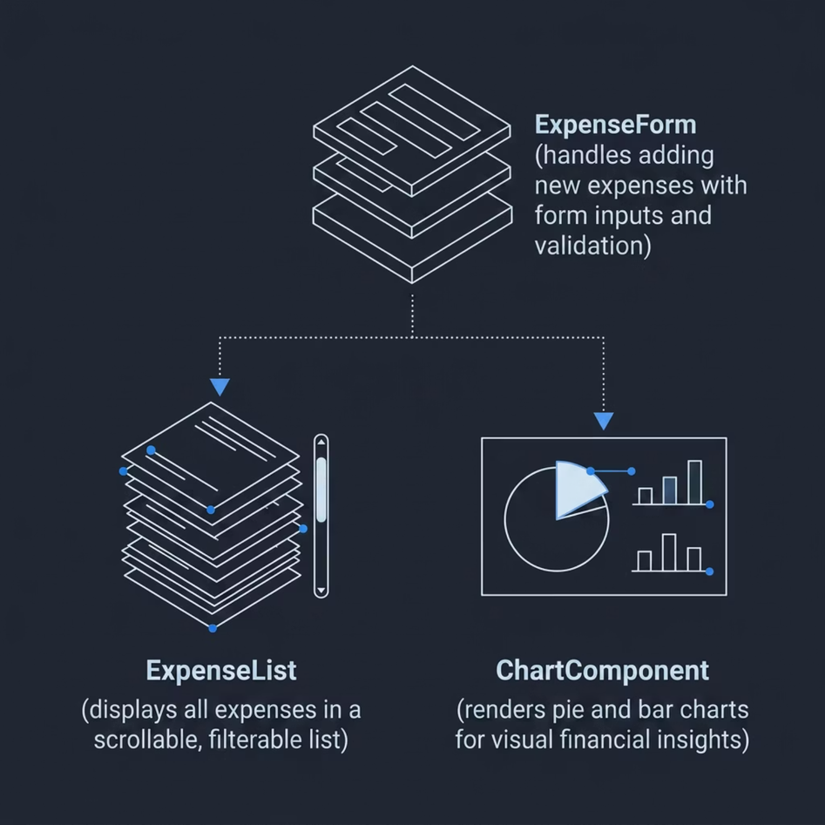
Component Structure & UI Features
What Each Component Does
ExpenseForm
Input fields for amount, category, and date — triggers POST requests
ExpenseList
Fetches and renders all expenses; supports delete actions per entry
ChartComponent
Subscribes to expense state and renders visual breakdowns in real time
Notes:
28

Slide 29

Data Visualization with Recharts
Numbers alone don't tell a story — charts do. Recharts converts raw expense data into interactive visuals that make financial patterns immediately clear.
Pie Chart
Bar Chart
Category-wise spending breakdown — see where your money actually goes
Monthly expense comparison — track trends and spot overspending fast
Live Data Binding
Charts re-render automatically when new expenses are added or deleted
Notes:
29

Slide 30
THANK YOU!
Notes:
28

